Slide 1
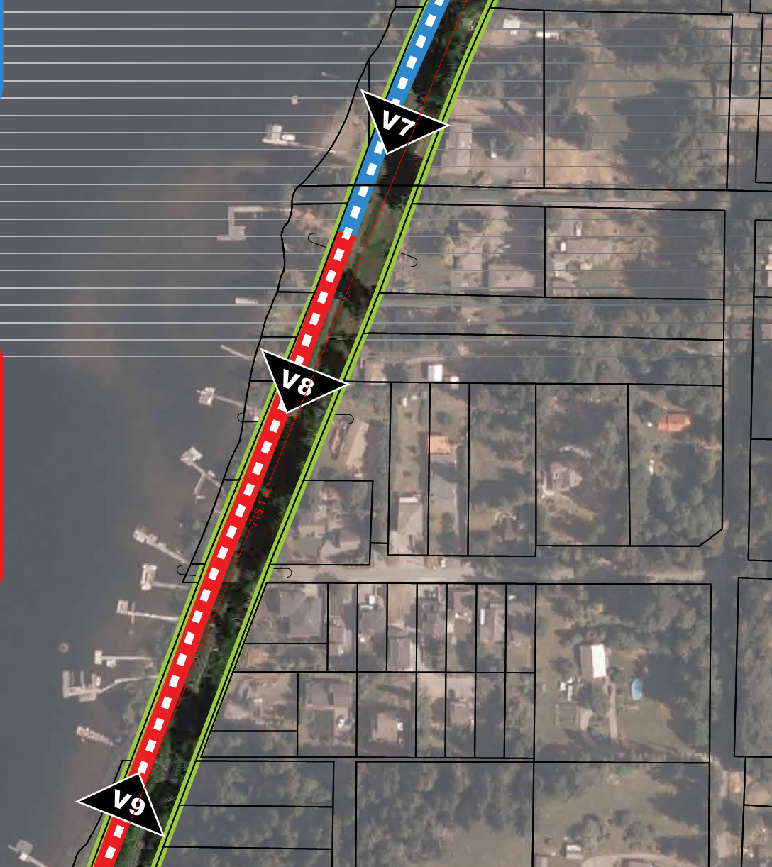
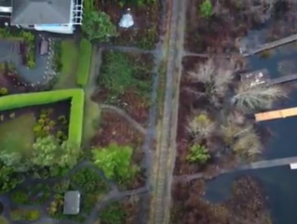
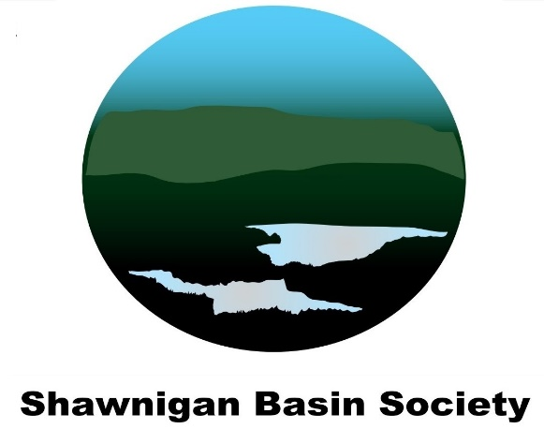
Potential Environmental Impacts - Proposed Shawnigan Village Rail Trail - Sections 3, 4 & 5
PREPARED FOR:
The Shawnigan Lake Community for presentation to
Cowichan Valley Regional District
175 Ingram Street
Duncan, BC
V9L 1N8
PREPARED BY:
Shawnigan Basin Society
#102 - 1760 Shawnigan Lake-Mill Bay Rd.
PO Box 189
Shawnigan Lake, BC
V0R 2W0

Slide 2
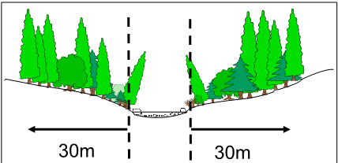
Riparian Zone Regulations
Defined by a 30-meter (98ft) setback from high water mark
Extremely important component of healthy watersheds
Environmentally sensitive area
Important food sources and shelter for aquatic insects and fish
Provides critical habitat for insects, amphibians, and other wildlife.
Riparian Areas Protection Regulation (RAPR)
Guidelines used in development of Shawnigan Village Official Community Plan (OCP)

Slide 3
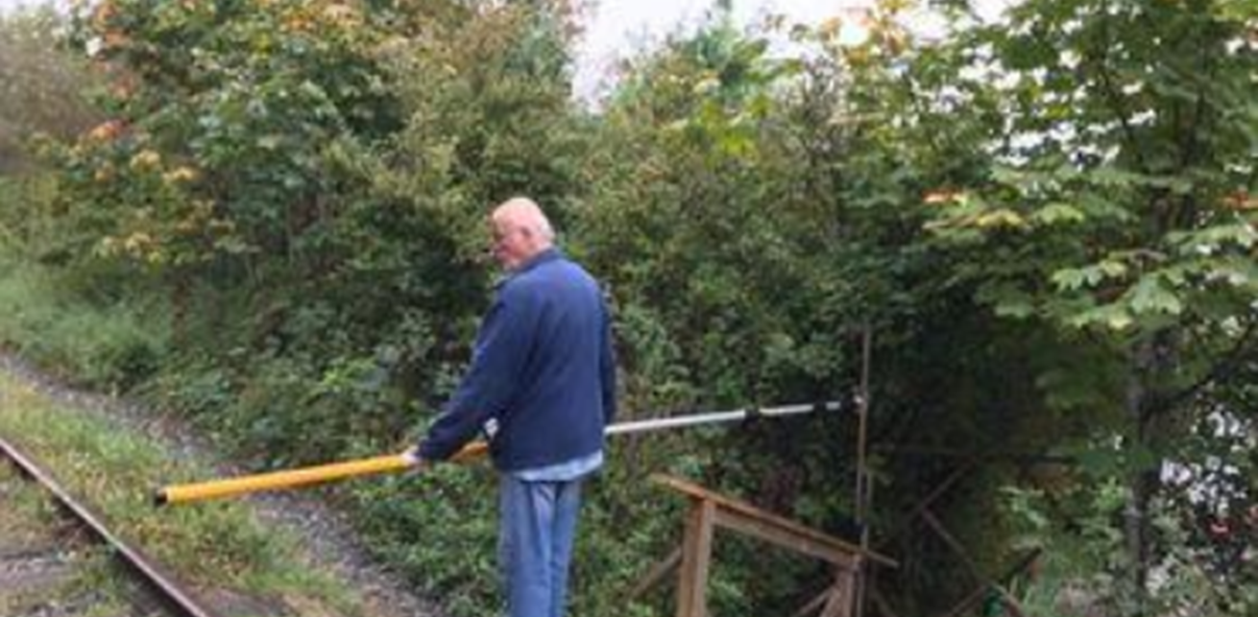
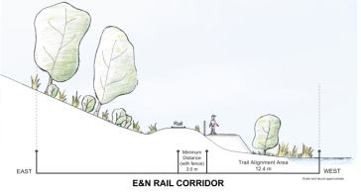
SBS Field Survey
SBS conducted a field survey on Sept 18th , 2020
Collection of 26 survey points
Photographing effected riparian zone.
Aerial survey of SVRT.
Observations
High-water above level shown on topographical maps
Within a couple of meters of the railway track
Two creeks cross under rail lines.
Numerous mature trees including arbutus, maples and Douglas fir would need to be felled.
Impact to the riparian zone and re-contouring of shoreline unavoidable.

Slide 4
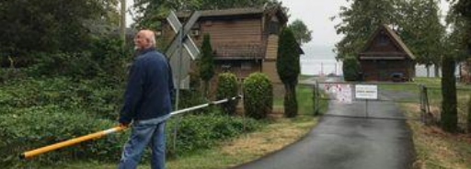
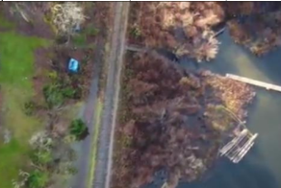
Potential Environmental Impacts
Sections 3, 4 and 5 fall completely within the riparian zone
Multiple (50>) mature trees including will be cleared.
Much of the natural undergrowth vegetation will be removed or disturbed.
Reduction of available wildlife and invertebrate habitats.
Work within the riparian zone likely to increase erosion and sedimentation.
Fill material will be required to grade and level the area.
Importation of fill material to the riparian zone can introduce invasive species.
Installation of culverts increase risks of sedimentation.
The natural contour and gradient of the shoreline and riparian zone will be lost.
Will have a negative affect on fish spawning and invertebrate habitat.
Operation of heavy machinery may cause disturbance to the shoreline.
Post-construction bank stability may be an issue due to wave action

Slide 5
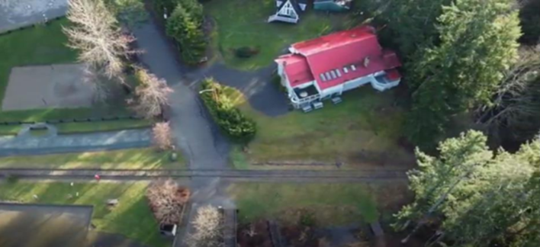
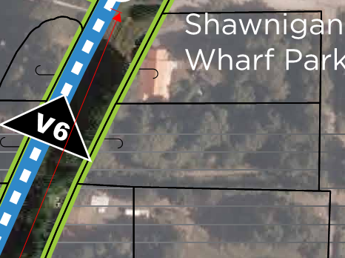
Conflicts and Public Information
The proposed SVRT intersects a total of;
3 public lake access zones (W-4 Zoning);
2 ephemeral creeks;
21 residential properties; and,
1 private lane.
Currently there is no publicly available information provided by the CVRD regarding:
A detailed design drawing of the proposed SVRT.
A design plan and locations for culvert installation.
Proposed environmental management plan
Reinstatement of private property boundaries.
Maintaining public lake access zones.
Mitigation of habitat loss within riparian zone and shallows.
The restoration of the riparian zone.

Slide 6
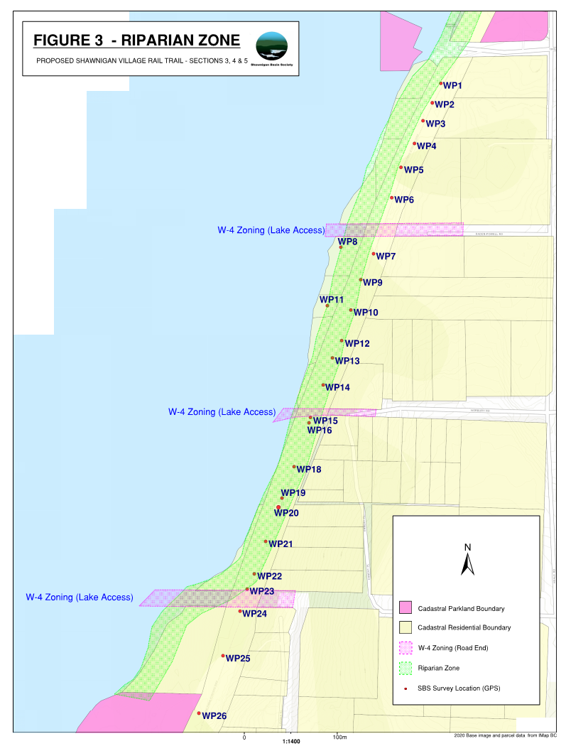
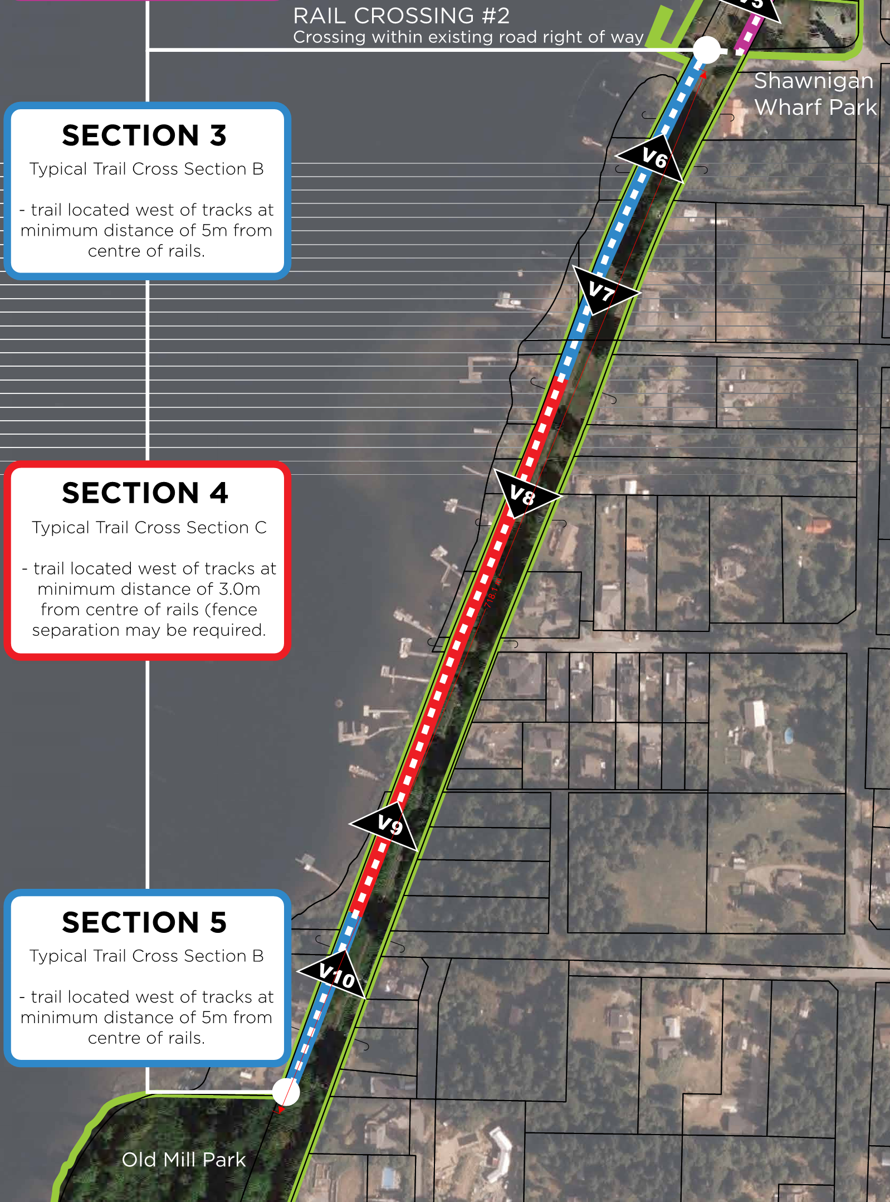

Slide 7
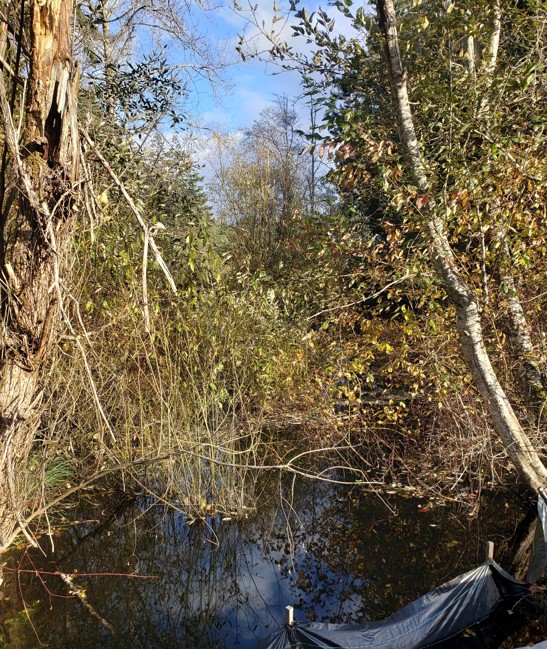
Question & Answer Riparian area protection Wetlands at Work

